Slide 1
EXZELLENZ
VERBINDET –
BE PART OF A
WORLDWIDE NETWORK
Speaker
Function
Date
Name of event

Slide 2
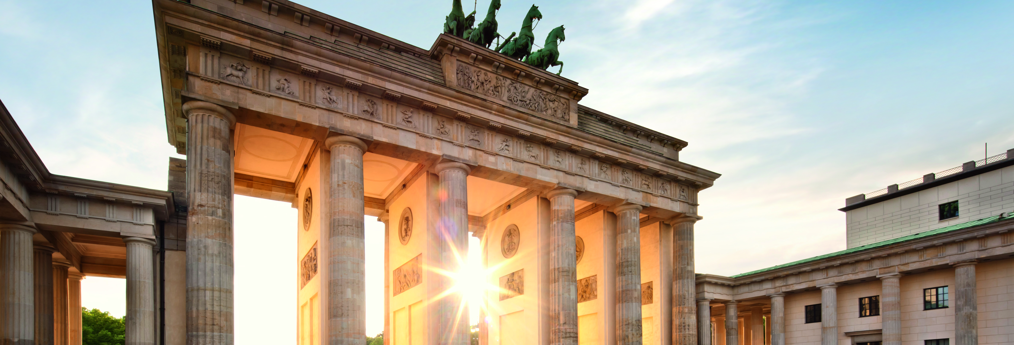
GERMAN CHANCELLOR FELLOWSHIP for prospective leaders

Slide 3
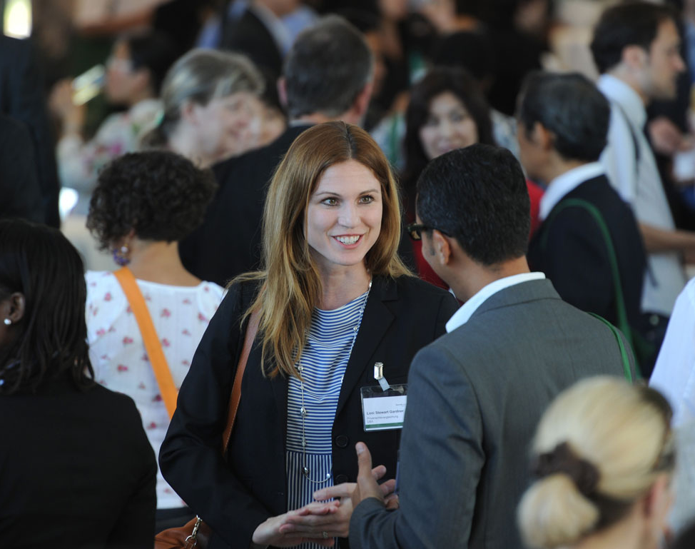
THE HUMBOLDT FOUNDATION AT A GLANCE
    Academic collaborations between excellent international and German researchers
    Sponsorship throughout lifetime
    A network of 30,000 alumni worldwide
    International understanding, diplomacy, scientific progress and development

Slide 4
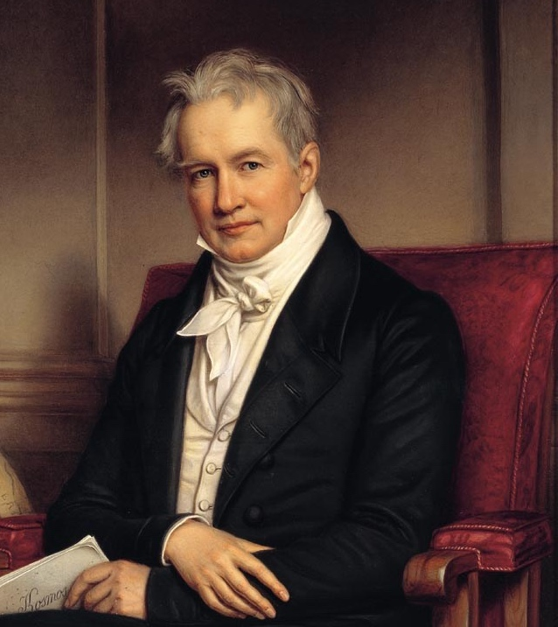

OUR ROOTS
Alexander von Humboldt (1769 – 1859):
explorer, universal genius, cosmopolitan and sponsor of excellent scientific talent
1953: Establishment of today’s Alexander von Humboldt Foundation, based in Bonn Bad-Godesberg
International network of academic cooperation, modelled on Humboldt

Slide 5
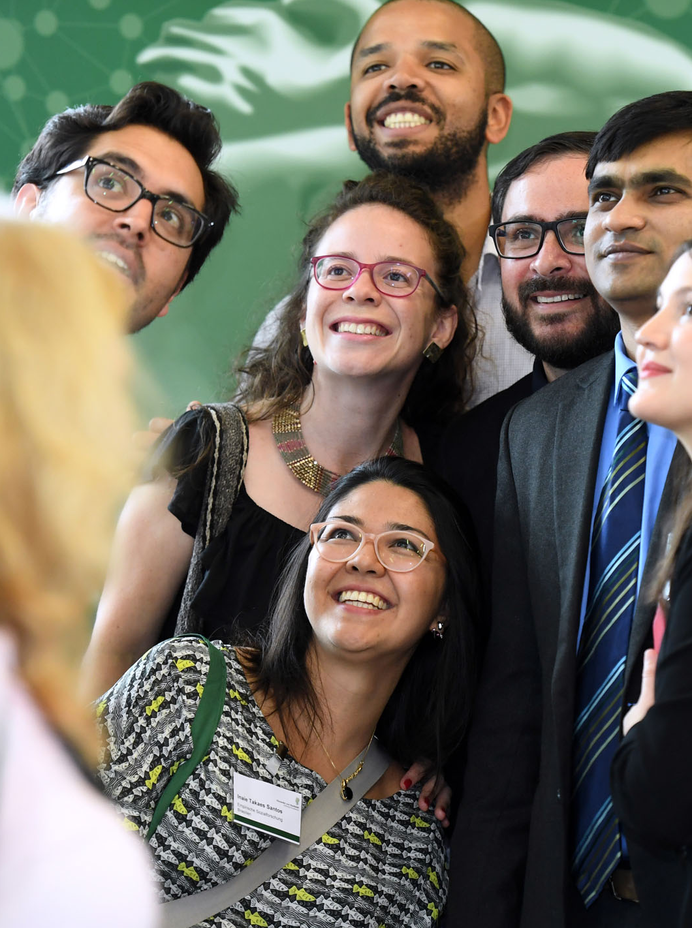
GERMAN CHANCELLOR FELLOWSHIP
    Graduates with initial leadership experience
    Self-chosen project with a host and collaborative partner in Germany
    Exploring new solutions to the global challenges of our times, engaging in societal dialogue
    International networking and establishing long-lasting contacts to Germany
5 | 22.06.2023

Slide 6






EXTENSION STEP BY STEP
1990
Founded on the initiative of
Helmut Kohl with focus USA
2002
Extended on the Initiative of Gerhard Schröder to the Russian Federation*
2006
Extended on the initiative of Angela Merkel to the PR
of China
2013
Extended on the initiative of Angela Merkel to India
and Brazil
2021
Extended on the initiative of Angela Merkel to South Africa
* suspended due to the war against Ukraine

Slide 7

IDEAS CAN ONLY BEAR FRUIT
IF THEY TAKE ROOT IN MANY MINDS.
OUR NETWORK
„
Alexander von Humboldt
World-spanning Humboldt Network transcending the boundaries of disciplines and countries
Scientific solutions to the challenges of our times
A network of trust and understanding
7 | 22.06.2023

Slide 8
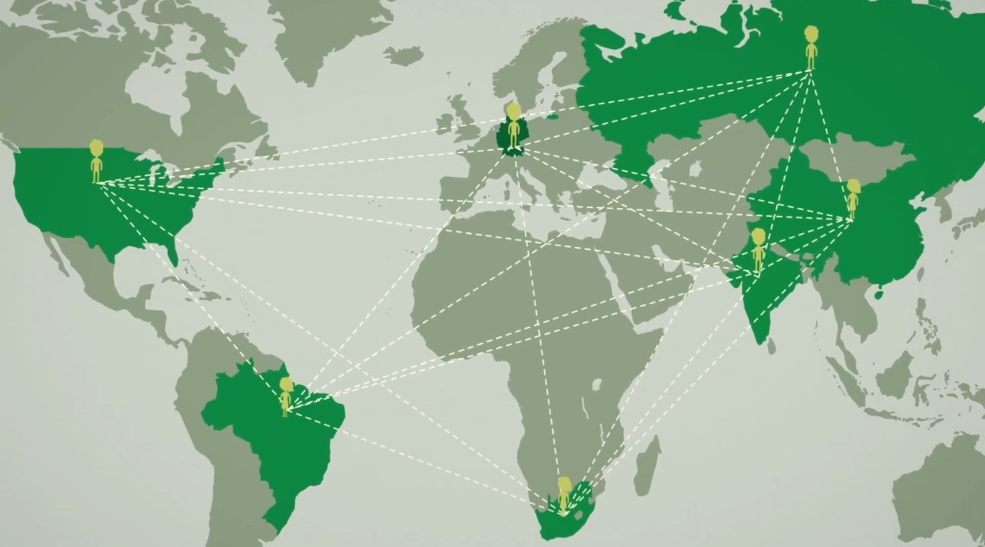
NETWORK GERMAN CHANCELLOR FELLOWSHIP
182
325
150
85
813
German Chancellor Fellows
95
12
as of May 2023

Slide 9
TARGET GROUP
PERSONALITY
Accomplished young professionals and promising university graduates
Interest in international issues
POTENTIAL
Proven leadership potential
Prospective decision-makers, multipliers and thought leaders in their fields
BACKGROUND
University graduates from all disciplines
Young professionals from broad range of professional fields

Slide 10
TARGET AREAS
Public Administration
Politics
Business
Society and Culture
University Graduates

Slide 11
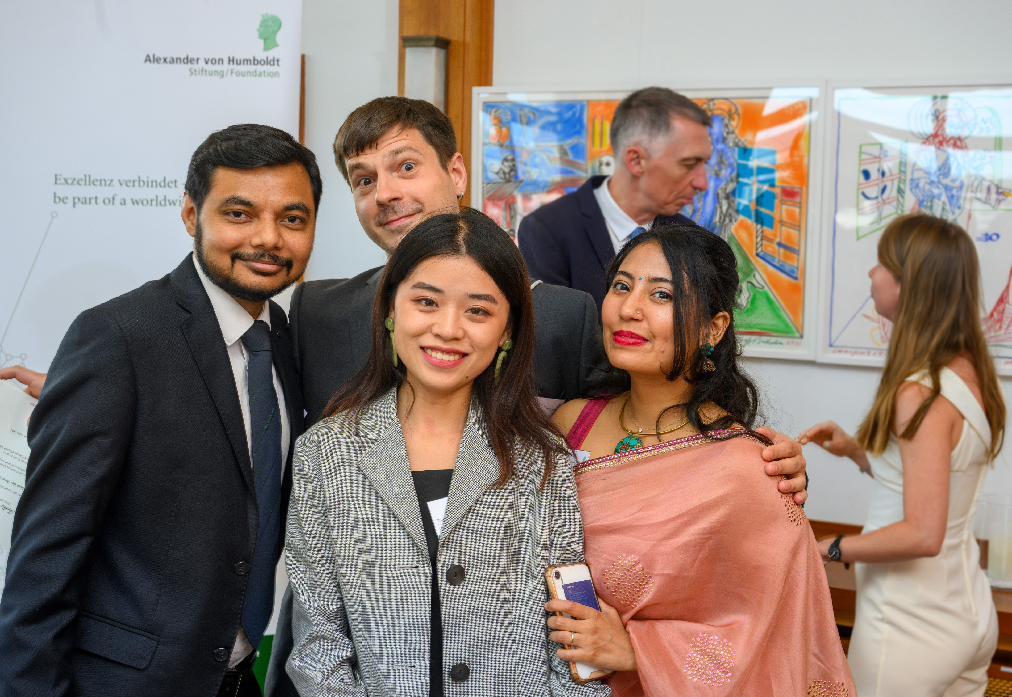
FELLOWSHIP BENEFITS
    Fellowship amount to cover living costs in Germany (2000€, 2300€, 2600€ per month)
    Various allowances: Mobility, insurance, lump sum for travel expenses, family allowances etc.
    Subsidy towards research costs to the host in Germany
    Europe allowance for stay in another European country
    German language course

Slide 12
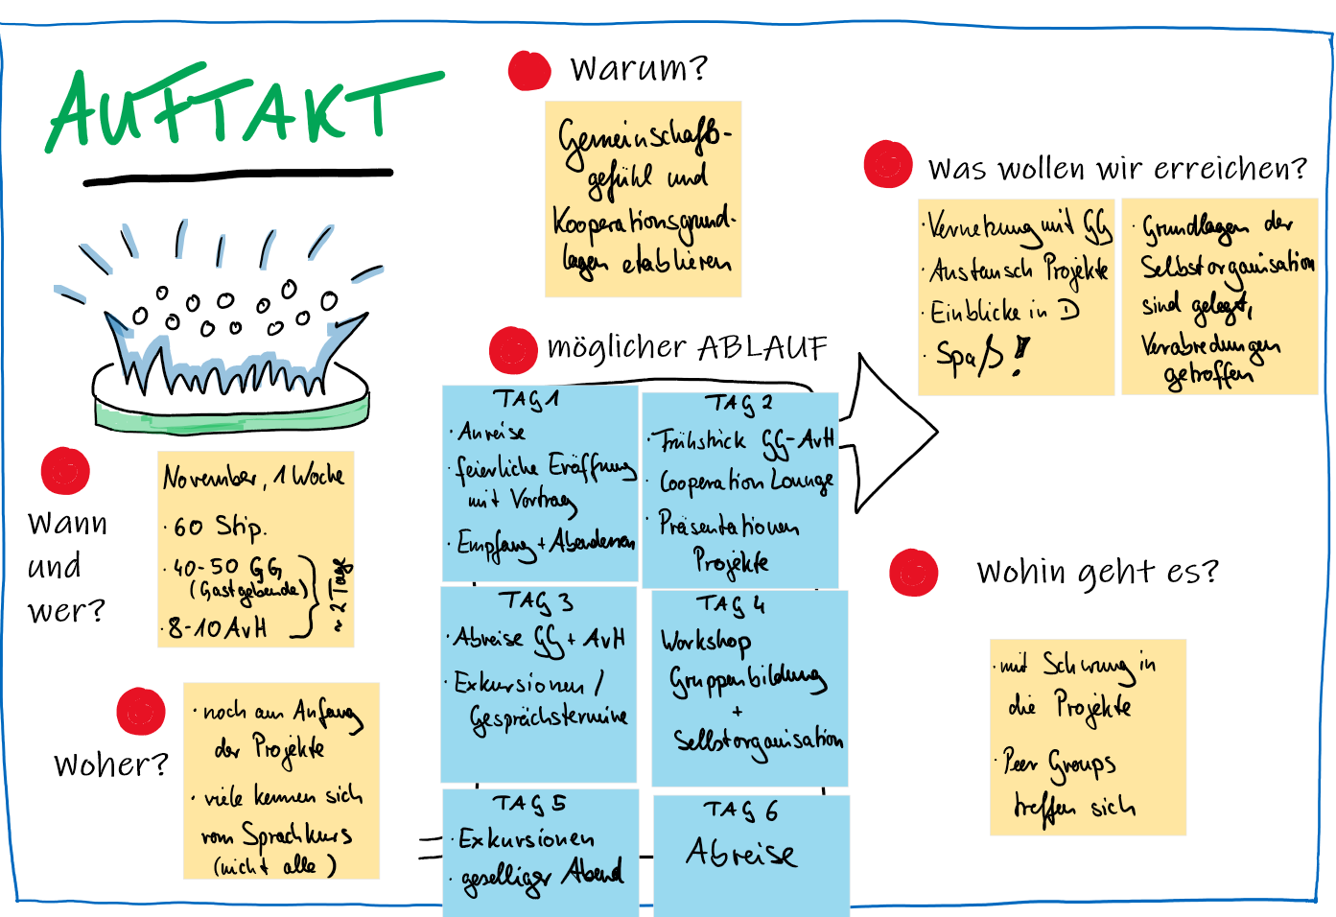
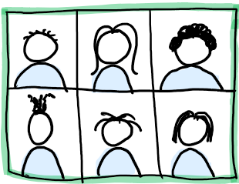
NETWORKING EVENTS
Opening Conference
Series of online meetings throughout the fellowship year
Half-time Conference
Meeting in Berlin
Humboldt Annual Meeting
in-person
Peer groups
(self-organised)
Humboldt Study Tour

Slide 13
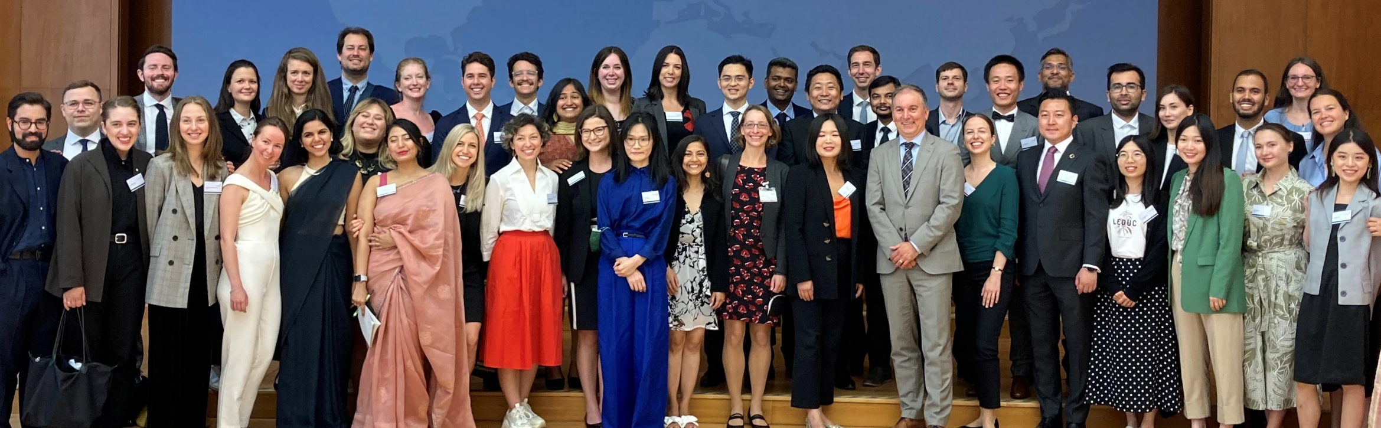
GERMAN CHANCELLOR FELLOWS at the FOREIGN OFFICE

Slide 14

APPLICATION REQUIREMENTS
Citizenship in one of the target countries
Initial proven leadership experience
Project plan designed by the applicant and feasible to be completed during the fellowship
Confirmed host in Germany
Two letters of recommendation
First academic degree completed less than 12 years before the fellowship’s beginning

Slide 15
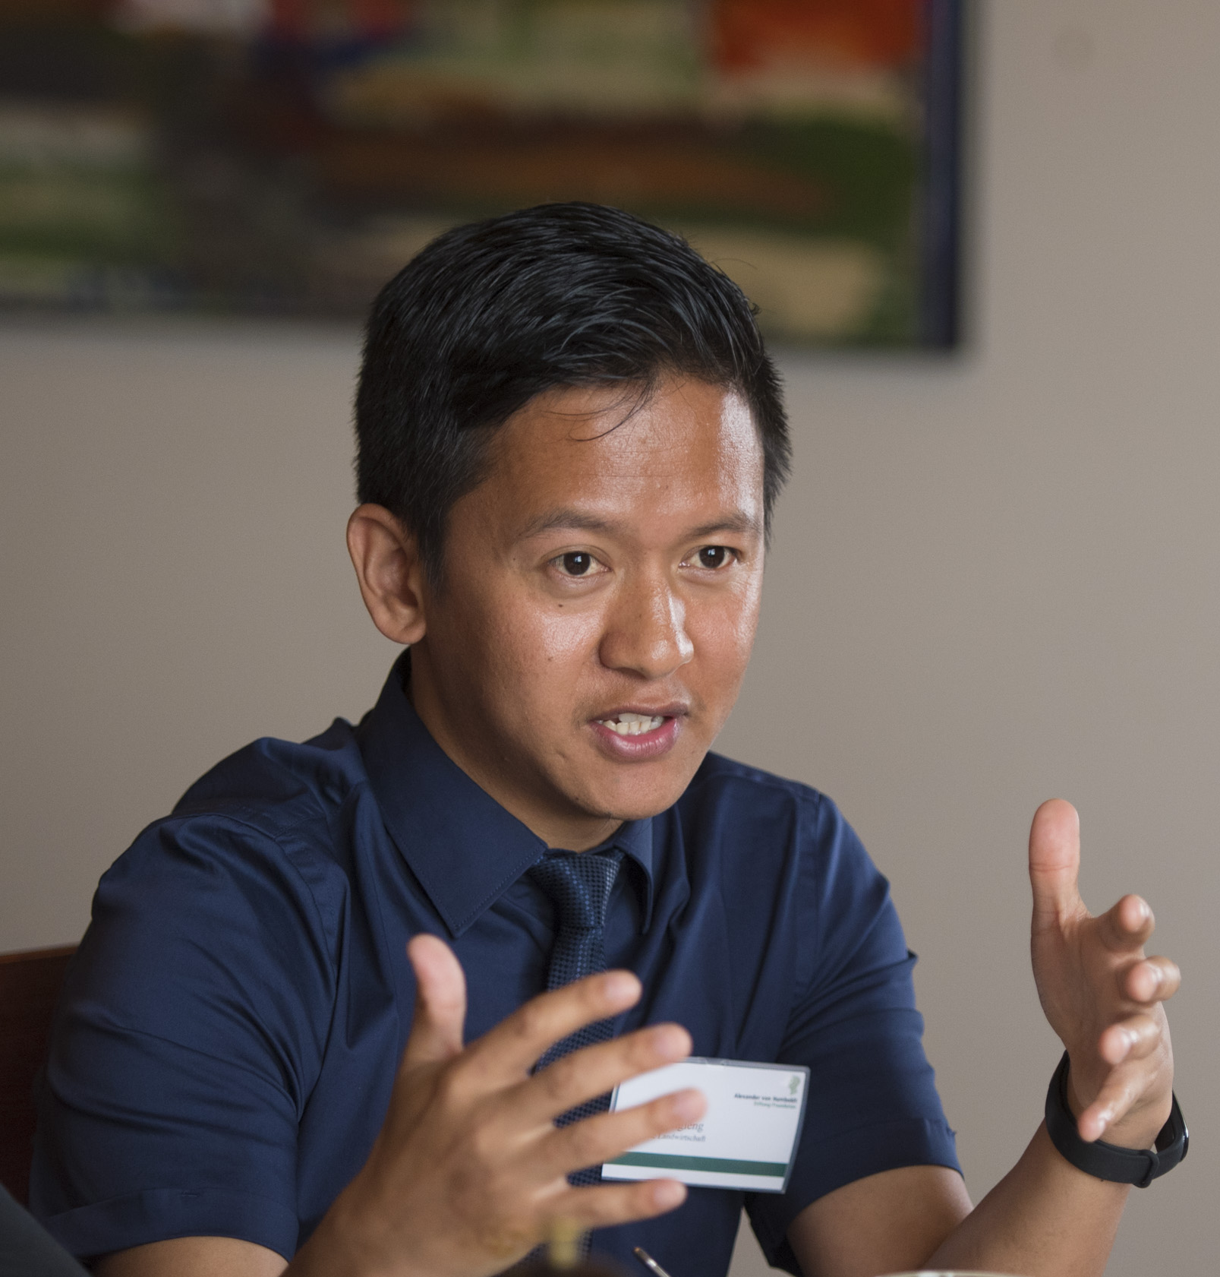
SELECTION CRITERIA
Previous career and leadership potential
Significance of the fellowship for further career development
Potential to build bridges between home country and Germany
International outlook and future role as an international leader
Existing knowledge to help ensure success of the project
Relevance of the project for the dialogue of modern societies

Slide 16

ADVICE ON FINDING A HOST
Anyone who works for a public or private institution in Germany can be a host.
The host must have a discipline-related or professional link to the project.
Applicants should start their search for a host as early as possible!
Sources of assistance with the search
for a host:
  www.humboldt-foundation.de/youngleaders
  Alumni associations of German
  Chancellor Fellows
  German companies and organisations in the programme countries

Slide 17
TIMELINE
Application procedure
Call
15 March 2023
Application deadline
15 October 2023
Selection meeting
Spring 2024
Fellowship
Individual trajectory:
Cohort activities:
German language course
up to 3 months
Recommended: July-September 2024
Time frame:
1 August 20224– 31 March 2026
Individual Project
12 Months
Regular starting date: 1 October 2024
Opening Conference (1 week)
November 2024
Half-Time Retreat (1 week)
Spring 2025
Berlin Meeting (3 days)
Summer 2025

Slide 18

TESTIMONIALS…
…and more on our website and on youtube

Slide 19
THANK YOU
www.humboldt-foundation.de
info@avh.de
+49 228 833-0
@AvHStiftung
www.youtube.com/AvHStiftung

Slide 20
