Slide 1
EXZELLENZ
VERBINDET –
BE PART OF A
WORLDWIDE NETWORK
Speaker
Function
Date
Name of event
Notes:
At this point, the presenter should declare and explain his/her relationship to the Foundation. If the presenter is not a member of staff, he or she should make clear why the Foundation’s work is so important to him/her that he/she is presenting the work of the Foundation.
At the same time, it should be made clear that, not being a member of staff, the presenter cannot answer every question in detail. He/she cannot definitively confirm whether someone is really suitable for a specific sponsorship programme. Nor can he/she agree to award funding. It is important to point out that the listeners can find all the details on the Alexander von Humboldt Foundation’s website and are welcome to get in touch with the Foundation at any time. The contact details are given at the end of the presentation.

Slide 2
CONTENTS
What we do
Our roots
Our network
Sponsorship opportunities
Notes:
At this point, the presenter should provide an overview of the contents of the presentation.

Slide 3
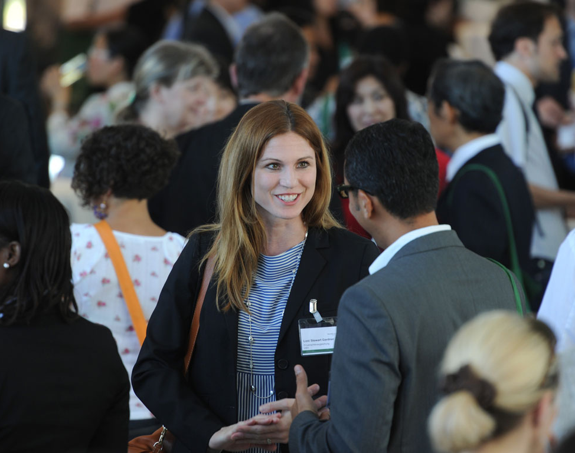
WHAT WE DO
    Academic collaborations between excellent international and German researchers
    Sponsorship throughout lifetime
    A network of 30,000 alumni worldwide
    International understanding, diplomacy, scientific progress, and development
    Internationalisation of Germany as a research location
Notes:
The Alexander von Humboldt Foundation is active in various fields:
It supports international academics as part of foreign cultural and educational policy as well as outstanding German researchers. The academic collaborations between excellent international and German researchers are part of “science diplomacy”, which is focused on dialogue, understanding, and building intercultural competence.
It strengthens cutting-edge research through internationalization.
It enables individuals who provide an impetus for the research location Germany to spend time researching there.
It promotes development by sponsoring cooperation with researchers from emerging and developing countries.

Slide 4
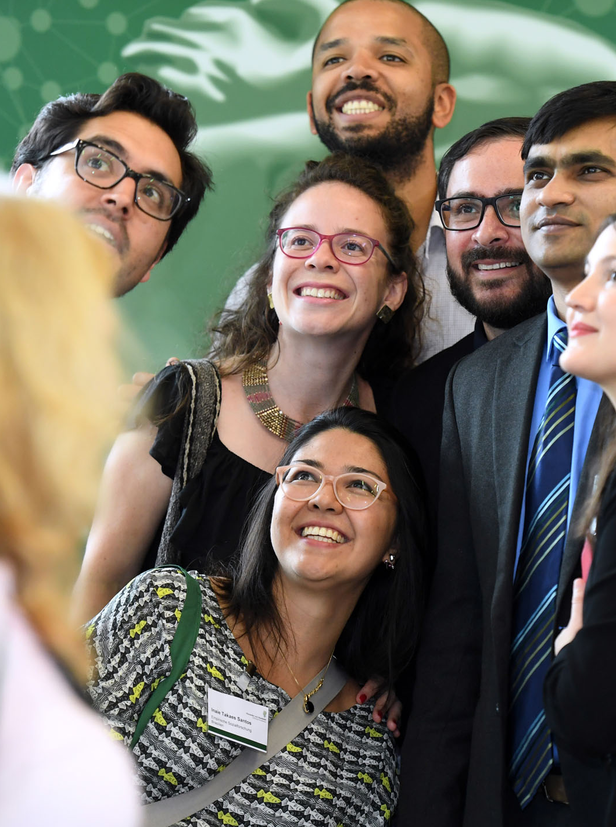
WHAT WE DO
    Research fellowships and research awards for researchers from abroad
    Chosen research area with a host and collaborative partner in Germany
    Alexander von Humboldt Professorship: Germany’s most valuable research award
4 | 27.04.2026
Notes:
The Alexander von Humboldt Foundation enables highly-qualified postdoctoral scientists and scholars from abroad to carry out research projects of their own choice in Germany. Researchers of all nationalities and disciplines may apply for a Humboldt Research Fellowship for postdoctoral researchers or a Humboldt Research Fellowship for experienced researchers. Furthermore, highly-qualified researchers from emerging and developing countries (excluding India and the People‘s Republic of China) may apply for a Georg Forster Fellowship for postdoctoral researchers or a Georg Forster Fellowship for experienced researchers. The subject of the research proposal must be of relevance to development and particularly suited to the transfer of knowledge and methods to developing countries.
The Alexander von Humboldt Professorship, which is financed by the Federal Ministry of Education and Research, enables award winners to carry out long-term, ground-breaking research at universities and research institutions in Germany. One objective of the programme is to tap academic expertise from abroad for research in Germany on a permanent basis; another is to support universities in redefining research focus areas.
The award amount, totaling 5 million euros for academics in experimental disciplines and 3.5 million euros for researchers in theoretical disciplines, is made available for a period of five years. It covers the financial outlay for research work and an administrative lump sum for the receiving institution. The award sum also includes personal salary which may not exceed €180,000 per year.
Nominations must be submitted to the Alexander von Humboldt Foundation via the rectors or presidents of the respective university and, where relevant, the academic directors or boards of non-university research institutions. Direct applications are not accepted. Nominations may be submitted during ongoing appointment procedures.

Slide 5
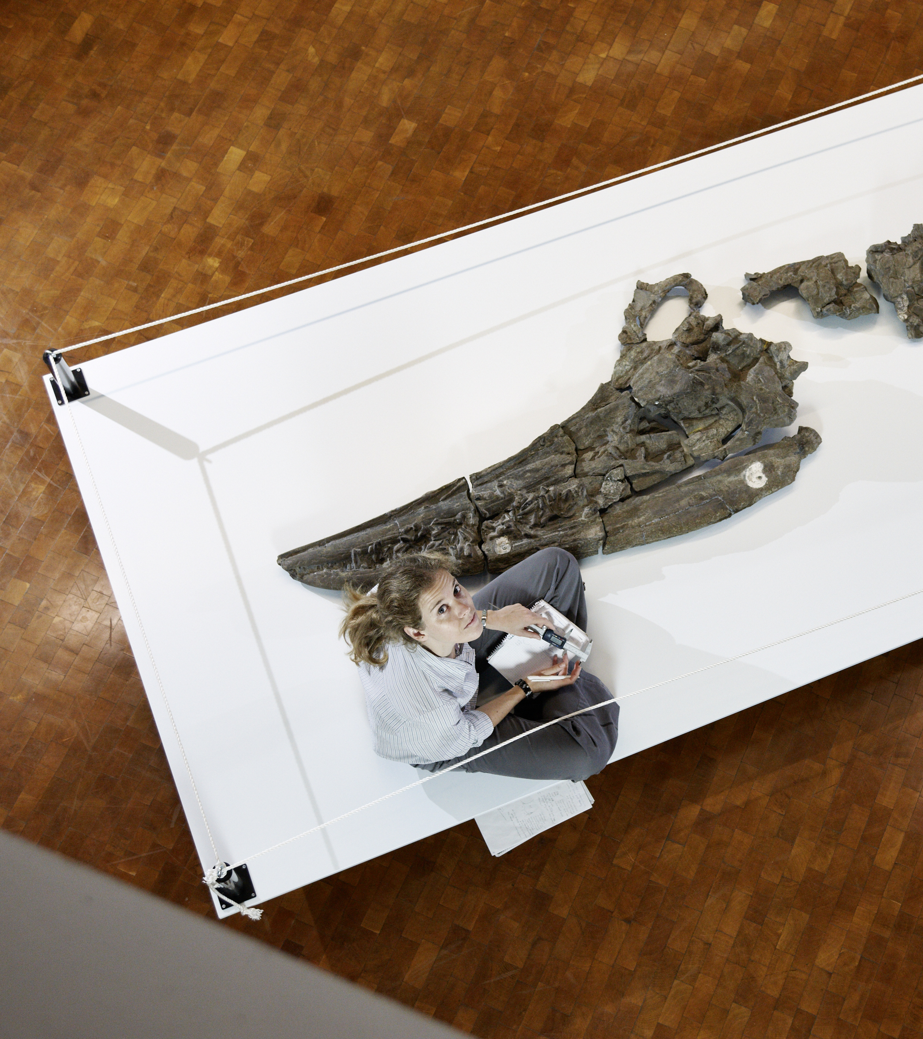
WHAT WE DO
    Research fellowships for researchers from Germany
    Research as the guest of a member of the Humboldt network abroad
Notes:
Feodor Lynen Research Fellowships for postdoctoral researchers are the tool with which the Alexander von Humboldt Foundation enables highly-qualified scientists and scholars from Germany, who are just embarking on their academic careers and who completed their doctorates less than four years ago, to spend extended periods of research (6-24 months) abroad.
Furthermore, the Alexander von Humboldt Foundation enables highly-qualified scientists and scholars from Germany, who completed their doctorates less than twelve years ago, to spend extended periods of research (6-18 months; may be divided up into a maximum of three blocks of a minimum of 3 months each) abroad.
The applicant can use the fellowship calculator at https://www.humboldt-foundation.de/bewerben/foerderprogramme/feodor-lynen-forschungsstipendium/stipendienrechner-fuer-feodor-lynen-stipendien in order to calculate the approximate amount of the fellowship if the application is successful.

Slide 6
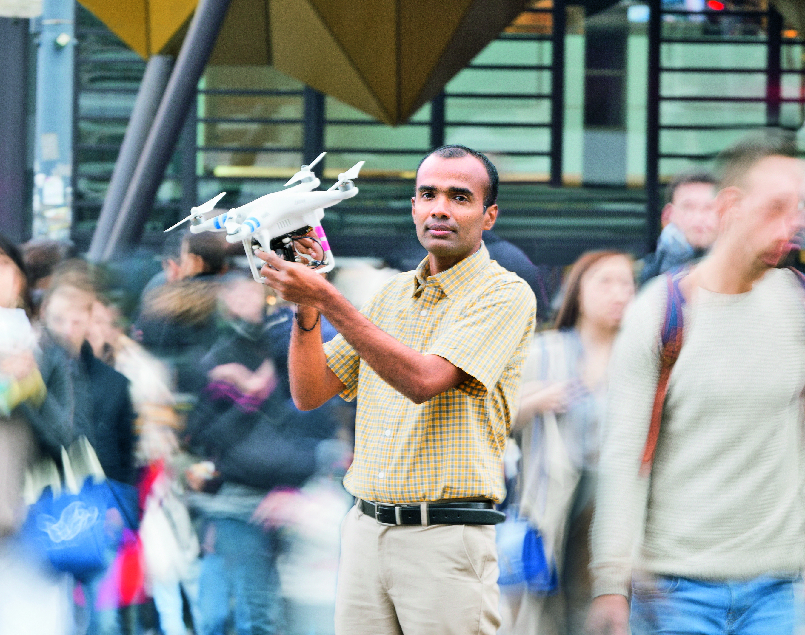
WHAT WE DO
    No quotas, neither for individual countries nor for specific academic disciplines
    The only thing that counts is the applicant’s academic record
    We support people, not projects
Notes:
The Alexander von Humboldt Foundation promotes outstanding researchers from Germany and abroad with its programmes. Sponsorship decisions are based on the applicant’s achievements and qualifications to date. There are no quotas, neither for countries nor disciplines. The Foundation believes that even in the times of increasing team work the ability of the individual is the crucial factor for academic success. This is why it sponsors people not projects. Those chosen on this basis should be given as much freedom as possible to carry out their research projects. This includes allowing Humboldtians to choose their host institutions themselves and to conduct independent research without any stipulations from the Foundation.

Slide 7

Equal opportunities
    Equal opportunities is an important priority for the Foundation
    Fellowship extension or interruption, allowances to support childcare
    Targeted counselling and provision of information
Notes:
As the Foundation's sponsorship programmes target both men and women, it consequently seeks to make its sponsorship programmes equally attractive to both male and female academics.
Nevertheless, it is evident that the proportion of female academics sponsored is significantly lower by comparison with their male colleagues and drops with a higher career stage and with increasing age. The geographical origin is also relevant.
For this reason the Alexander von Humboldt Foundation supplements its sponsorship options with the following equal opportunities measures:
Research fellows have the opportunity to extend the sponsorship period by up to 3 months if they give birth during the approved sponsorship period (in analogy to the periods laid down in the Maternity Protection Act); the opportunity to extend the sponsorship period is available even if the fellowship finishes within the statutory maternity leave period.
The research fellow can apply to interrupt the fellowship period for up to 18 months if the birth of a child occurs within the sponsorship period or if the research fellow (male or female) is responsible for the care of a child under 12 years of age.
Married research fellows receive a marital allowance if the accompanying spouse does not have any income of his/her own. If the fellows‘ underage children (under 18) accompany them to Germany for at least 3 months (without interruption) an application can be made during the sponsorship period to receive child allowance or child benefit according to German law. A childcare allowance can be paid for children of fellows from Germany who accompany them abroad and who are not older than 12.

Slide 8
HUMBOLDT FOUNDATION FINANCING
Budget 2026*: approx. 165.0 million euros, 98 percent financed through federal funds.
AA 32.0 %
BMZ 3.8 %
AA (IKI) 1.1 %
EU 0.1 %
Andere 1.4 %
BMFTR 61.6%
AA: Federal Foreign Office
BMFTR: Federal Ministry of Research, Technology and Space
BMZ: Federal Ministry for Economic Cooperation and Development
IKI: International Climate Initiative
EU: European Union
* according to the first version of the 2026 economic plan dated 19 November 2025

Slide 9
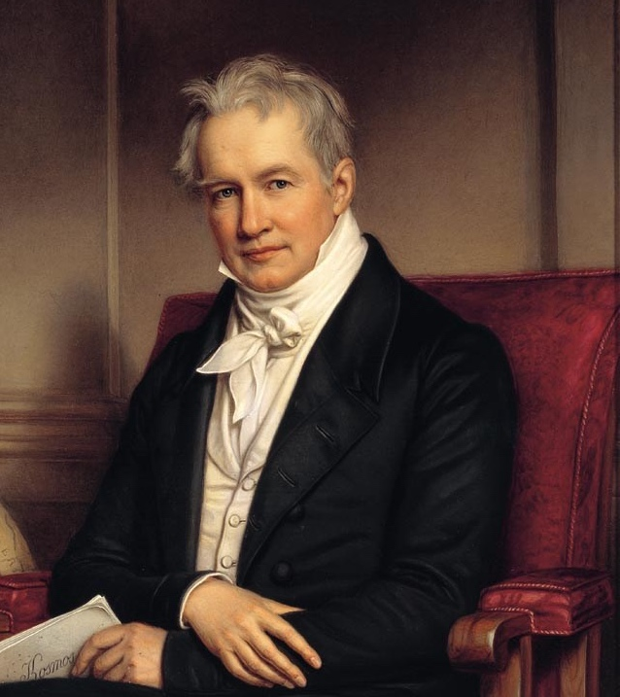
OUR ROOTS
Alexander von Humboldt (1769 – 1859):
mining engineer and natural scientist, explorer and polymath, citizen of the world and promoter of outstanding scientific talent.
Our international network of research cooperation was modelled after
Humboldt's example.
The foundation was originally established from the Humboldt family's assets.
Notes:
Alexander von Humboldt was a discoverer and cosmopolitan, a universal scholar and fighter for the freedom of research, a humanist and patron of excellent research talents. His lengthy Latin American journey from 1799 to 1804 was celebrated as the second scientific discovery of South America. Members of natural science disciplines such as physical geography, climatology, ecology or oceanography see Humboldt as their founder.
Humboldt was an early networker. He involved hundreds of scientists in collating information from the most diverse areas and built up his own network many young researchers in his orbit were able to benefit from. He did not only circulate data and commentaries around the world, but also information on jobs and positions.
The Alexander von Humboldt Foundation as it is known today was established in 1953 by the Federal Republic of Germany. In the spirit of Humboldt it fosters an international network of scientific cooperation and trust.

Slide 10
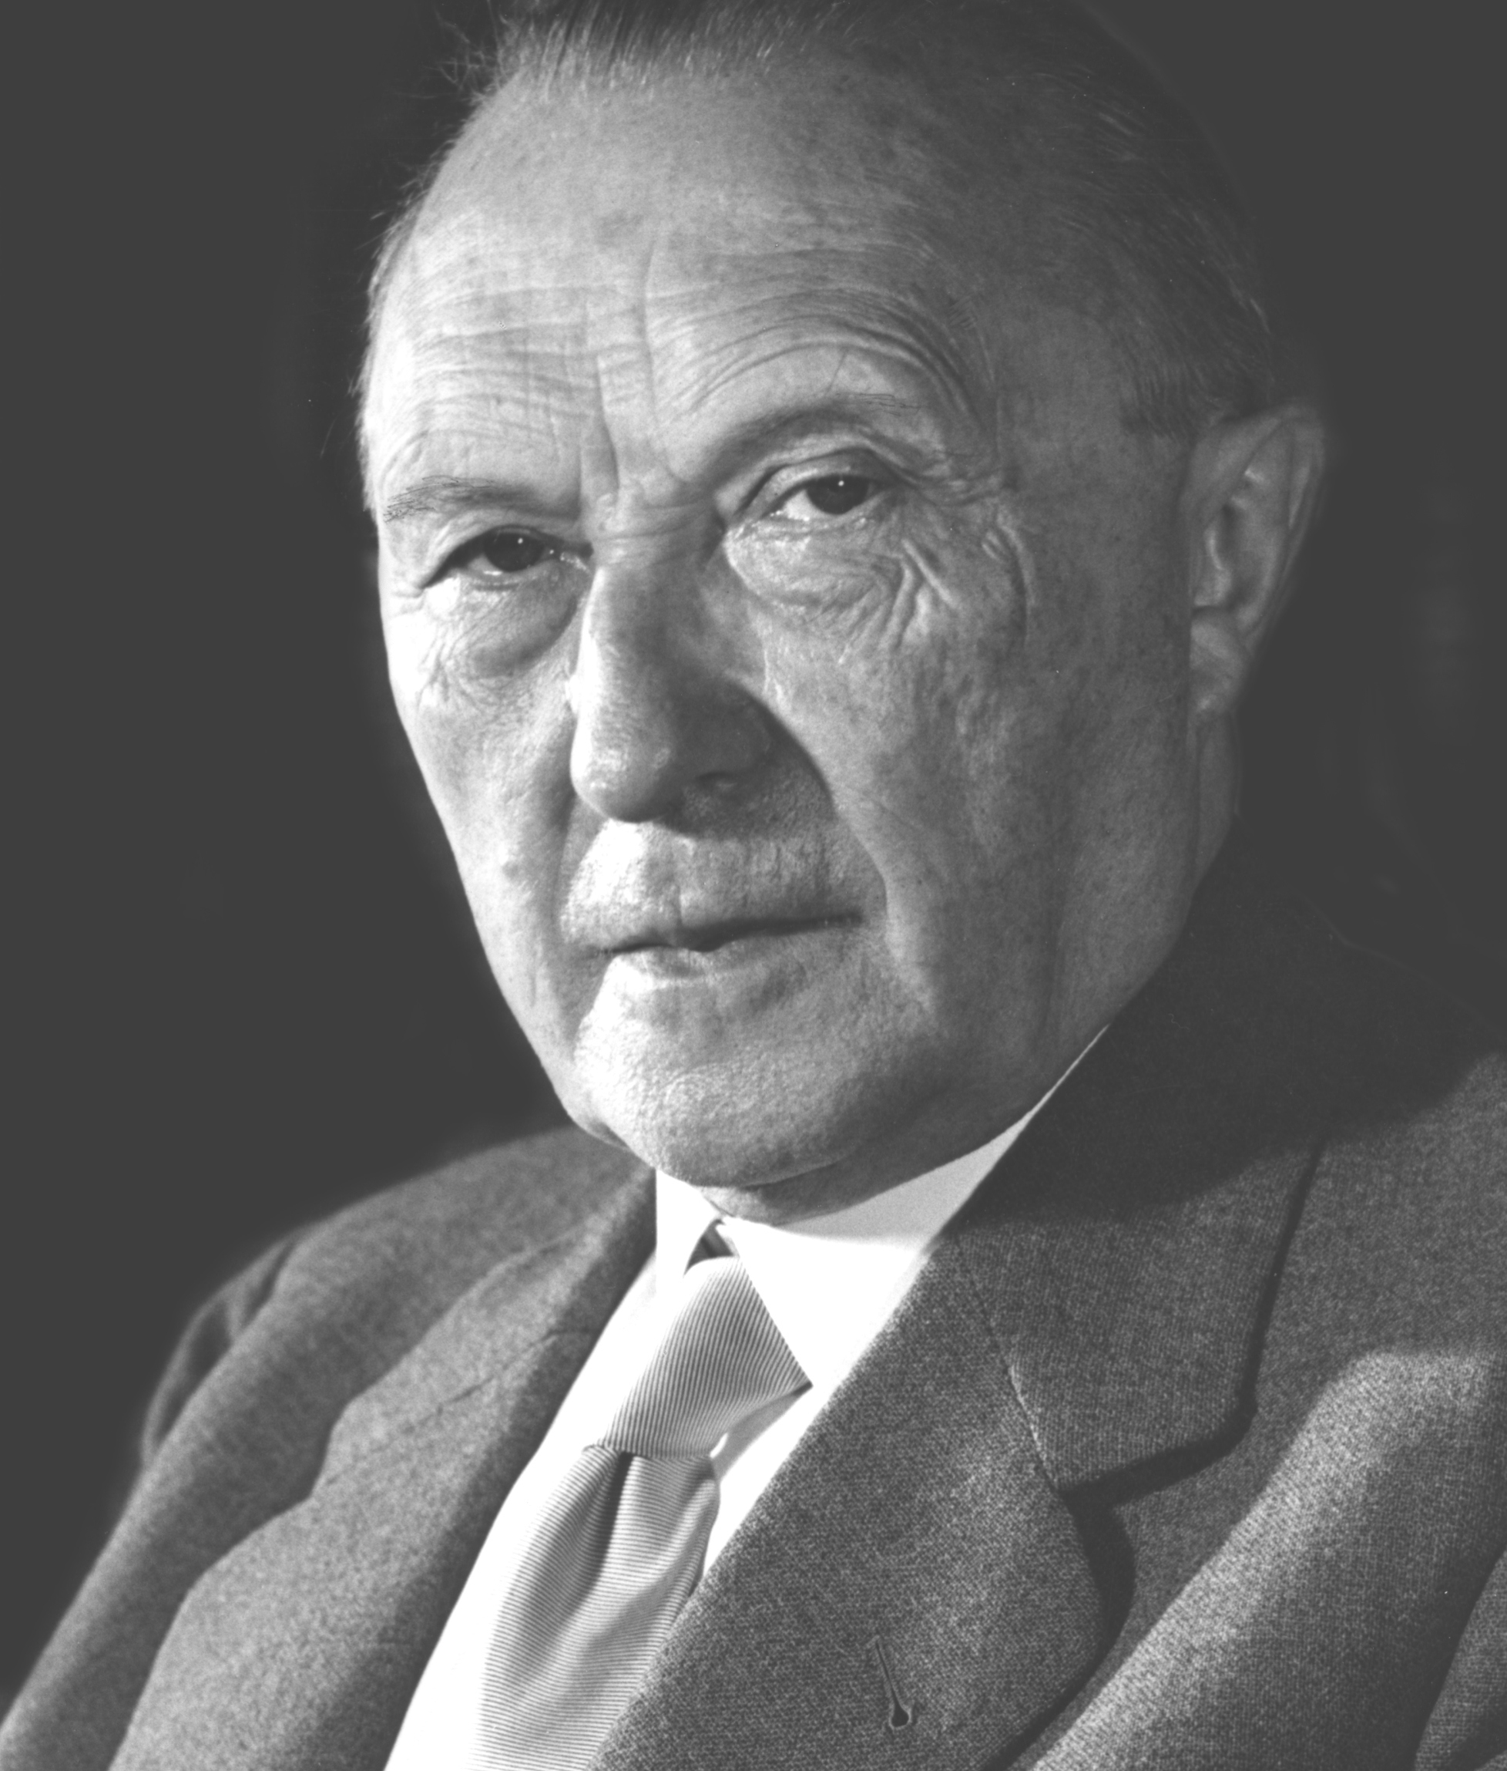
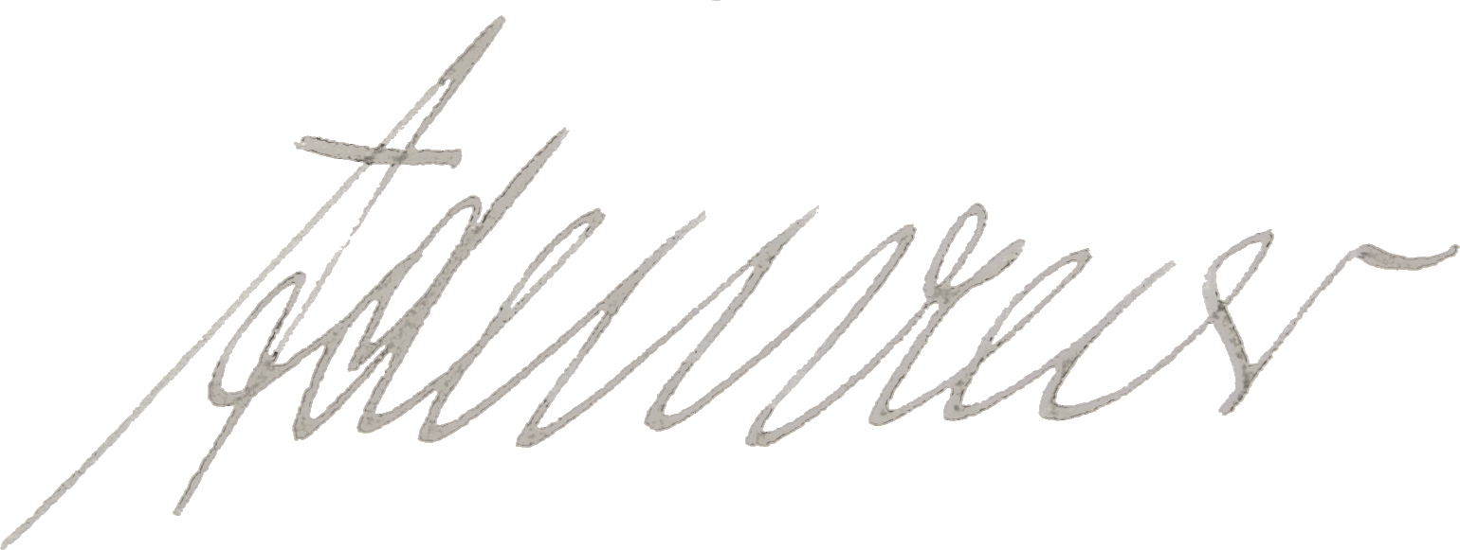
OUR ROOTS
The foundation was established by the Federal Republic of Germany; the foundation charter was signed by Federal Chancellor and Foreign Minister Konrad Adenauer (1876 – 1967).
Its aim is to promote science and research as well as intercultural understanding.
The foundation has been based in Bonn-Bad Godesberg since its inception.
© KAS _ Peter Bouserath
Notes:
Alexander von Humboldt war ein Entdecker und Kosmopolit, ein Universalgelehrter und Streiter für die Freiheit der Forschung, ein Humanist und Förderer exzellenter Wissenschaftstalente. Seine große Südamerikareise von 1799 bis 1804 wurde als die zweite, die wissenschaftliche Entdeckung Südamerikas gefeiert. Naturwissenschaftliche Disziplinen wie die physische Geographie, die Klimatologie, die Ökologie oder die Ozeanographie sehen in Humboldt ihren Begründer.
Humboldt war ein früher Netzwerker. Für seine Forschung beteiligte er Hunderte Wissenschaftler*innen am Zusammentragen von Informationen aus den unterschiedlichsten Gebieten. Diese Forschenden profitierten ebenfalls von diesem Humboldt-Netzwerk, denn dort wurden nicht nur Daten und Kommentare ausgetauscht, sondern auch Hinweise auf Jobs und Posten.
Die heutige Alexander von Humboldt-Stiftung wurde 1953 von der Bundesrepublik Deutschland gegründet. Sie pflegt – im Geiste Humboldts – ein internationales Netz der wissenschaftlichen Zusammenarbeit und des Vertrauens.

Slide 11

IDEAS CAN ONLY BEAR FRUIT
IF THEY TAKE ROOT IN MANY MINDS
OUR NETWORK
„
Alexander von Humboldt
World-spanning Humboldt Network transcending the boundaries of disciplines and countries
Scientific solutions to the challenges of our times
A network of trust and understanding
11 | 27.04.2026
Notes:
“Once a Humboldtian – always a Humboldtian" – from the very beginning this was the hallmark of the Alexander von Humboldt Foundation. Humboldt sponsorship is enduring: the Foundation is a lifetime partner, maintaining the connections on a long-term basis through its alumni sponsorship programmes. As a result, an active knowledge network of more than 30,000 Humboldtians has been laid across the whole academic world – embracing over 140 states. The alumni sponsorship measures provide flexible support for the individual life paths and development of Humboldtians. Moreover, the Foundation encourages its alumni to undertake their own initiatives and collaborations across disciplinary and national borders.
Amongst other things, networking sponsorship caters for further research stays to Germany. This gives fellows a chance to revitalize relationships to specialist colleagues and their institutes or make contacts with new partners, continue joint projects already underway, or build new collaborations.
The Research Group Linkage Programme allows Humboldtians to apply for sponsorship in order to cooperate over a period of three years with a researcher working at a German institute and additional cooperation partners in other countries. The Alexander von Humboldt Foundation regularly organises colloquia abroad to which it invites research fellows and research award winners living in the host country or region, as well as Feodor Lynen fellows working there.
Since 2002, the Alexander von Humboldt Foundation has provided financial support for Humboldt Alumni Associations as well as for individual Humboldtians to organize regional and specialist conferences. These Humboldt Kollegs have become one of the most popular instruments for strengthening regional and specialist networks. Apart from networking, the Kollegs serve to awaken the interest of young academics in the Foundation’s programmes and in Germany as a location for research.
The Alexander von Humboldt Foundation’s Humboldt Alumni Awards for innovative networking initiatives are granted to fellows and award winners abroad. Each award is valued at up to €25,000. Four awards are granted annually, including one that is earmarked to sponsor initiatives promoting networking between female academics. The awards are designed to support projects not covered by the Foundation's existing sponsorship and alumni programmes and to promote academic and cultural relations between Germany and the Humboldt alumni's own countries as well as to strengthen their collaboration in the respective regions.

Slide 12
OUR NETWORK
950
Awards and fellowships every year
Alumni in more than
140
countries
2300
Research stays in Germany every year

Slide 13
> 32,000
Humboldtians across the world
63
Nobel laureates
40
Conferences and meetings across the world every year
109
Humboldt alumni associations worldwide

Slide 14
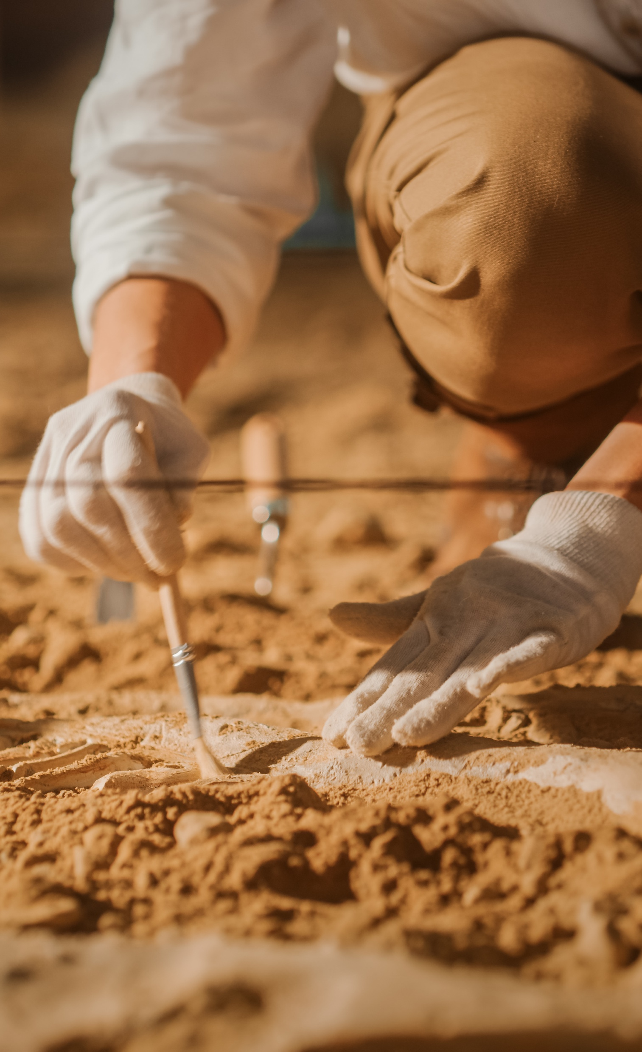
SPONSORSHIP OPPORTUNITIES
Research topic and academic host / unrestricted selection of collaborative partner in Germany
From postdocs and experienced researchers to world leaders: research fellowships and awards for every career stage
Notes:
The Alexander von Humboldt Foundation sponsors academic cooperation amongst excellent foreign and German academics. Annually, it grants more than 700 research fellowships and research awards that enjoy an outstanding reputation across the globe.
The Foundation‘s research fellowships and awards provide funding to suit every career situation – from young postdoctoral researchers at the beginning of their research careers to experienced researchers or world leaders in their research area.

Slide 15
MAJOR SPONSORSHIP PROGRAMMES AT A GLANCE
 | Researchers from abroad | Researchers from Germany
Postdoctoral researchers (up to 4 years after doctorate) | Humboldt Research Fellowship (Georg Forster Research Fellowship) | Feodor Lynen Research Fellowship
Experienced researchers (up to 12 years after doctorate) | Humboldt Research Fellowship (Georg Forster Research Fellowship) | Feodor Lynen Research Fellowship
(up to 18 years after doctorate) | Friedrich Wilhelm Bessel Research Award Humboldt Research Professorship
Internationally recognised researchers | Humboldt Research Award Georg Forster Research Award Alexander von Humboldt Professorship Humboldt Research Professorship
Notes:
The Alexander von Humboldt Foundation sponsors:
academics at different career stages, usually after completion of a doctorate
academics from abroad who wish to conduct research in Germany
academics from Germany who wish to conduct research abroad
(Design suggestion: Programmes that are not interesting or relevant for the specific audience can be displayed in gray font colour.)

Slide 16

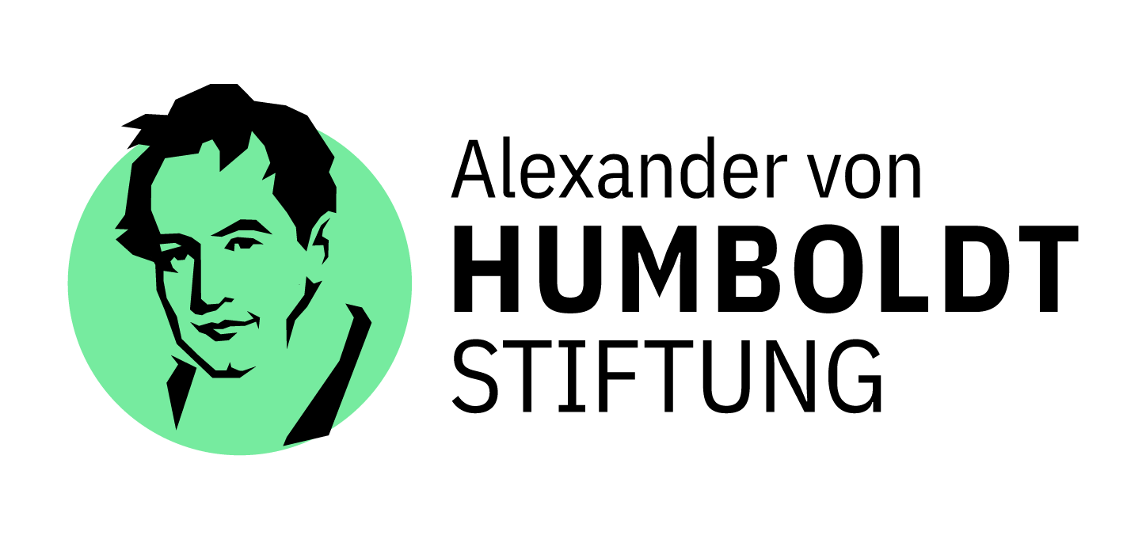


„1.000-Köpfe-Plus“-Programme / Global Minds Initiative Germany/

Slide 17

GLOBAL MINDS INITIATIVE GERMANY
    The “Global Minds Initiative Germany” offers international researchers career prospects in the German science system.
    The Initiative enables the AvH and the DFG to offer additional fellowships and invite top researchers to Germany in the context of existing funding programmes.
    We support people, not projects. The differentiated programmes aim at supporting individuals in all phases of their scientific careers.
    The internationally renowned funding programmes of both organisations enable a speedy start to a career in Germany.
    No quotas, neither for individual countries nor for specific academic disciplines. The only criterion is the applicant’s academic record.
Notes:
The Alexander von Humboldt Foundation promotes outstanding researchers from Germany and abroad with its programmes. Sponsorship decisions are based on the applicant’s achievements and qualifications to date. There are no quotas, neither for countries nor disciplines. The Foundation believes that even in the times of increasing team work the ability of the individual is the crucial factor for academic success. This is why it sponsors people not projects. Those chosen on this basis should be given as much freedom as possible to carry out their research projects. This includes allowing Humboldtians to choose their host institutions themselves and to conduct independent research without any stipulations from the Foundation.

Slide 18
FUNDING PROGRAMMES (AVH) IN GLOBAL MINDS INITIATIVE GERMANY
Humboldt Research Fellowship
Humboldt- /
Friedrich Wilhelm Bessel-
Research Award
Internationally recognised
researcher
Humboldt Research Professorship
Alexander von Humboldt Professorship
International top-tier
researchers
World-leading top
researcher
Research award for internationally leading scientists from abroad in all disciplines for their overall achievements to date.
Research award for top researchers from abroad to base their research in Germany, innovative research formats; relocation to Germany possible, but not a prerequisite.
Research award for world-leading top researchers working abroad, to finance a professorship in Germany, long-term and forward-looking research.
Research fellowship for exceptionally qualified researchers. Extended research stay in cooperation with hosts.
Forschungspreis für Spitzenforschende aus dem Ausland; Verankerung der Forschungsaktivität in Deutschland, innovative Forschungsformate; Wechsel nach D. möglich, jedoch keine Voraussetzung
Purpose
Application
Postdocs up to 4 years / Experienced researchers up to 12 years after completing their doctorate.
Nomination
Nomination by a scientist in Germany.
Nomination
Nomination by a university in Germany; co-nominations with a non-university research institution are possible.
Nomination
Nomination by a university in Germany; co-nominations with a non-university research institution are possible.
Prerequisites
Postdocs € 3,000* / 6-24 months
Experienced researcher € 3,600* / 6-18 months
* Monthly rate, plus benefits.
€ 80,000 / € 60,000 award money plus an invitation for a research stay in Germany for up to 12 months.
€ 1.5 - 3 Million for a period of 5 years.
Up to € 10 Million for a period of 7 years.
Funding and Duration

Slide 19
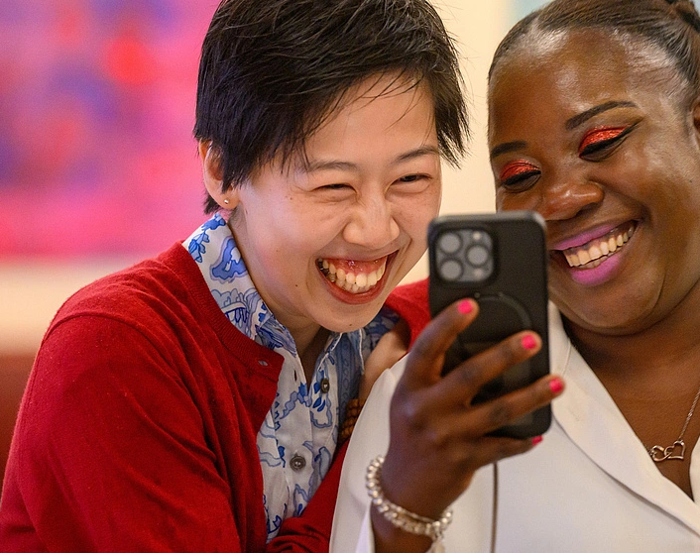
STAY CONNECTED: ALUMNI SPONSORSHIP
Once a Humboldtian, always a Humboldtian.
Funding opportunities for a lifetime
Renewed research stays in Germany
Events
Humboldt Alumni Associations

Slide 20
THANK YOU
Do you have any questions?
Speaker
Function
info@avh.de
www.humboldt-foundation.de/en

